Slide 1
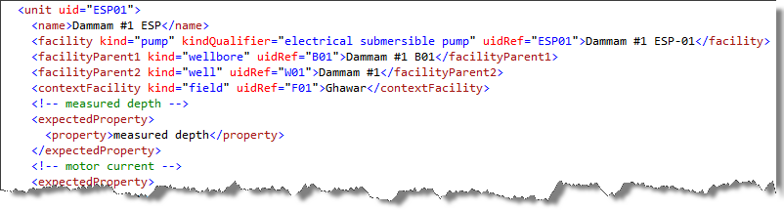
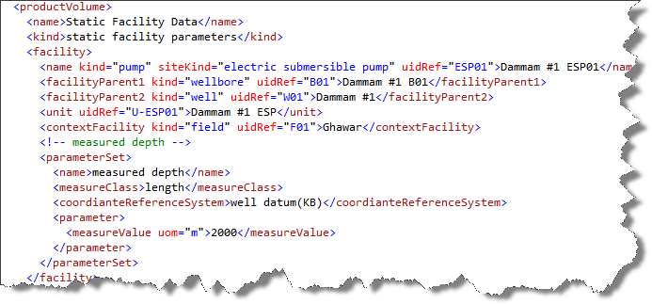
Measured Depth Example
Product Flow Model
Product Volume

Slide 2
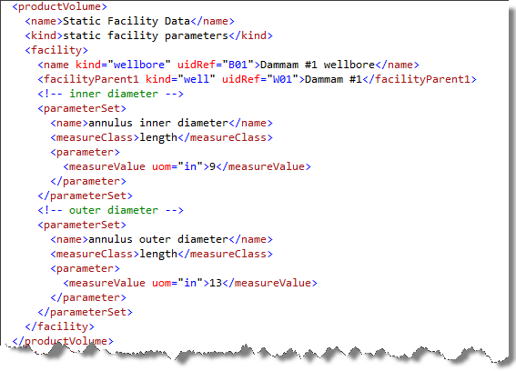
Annulus Size Example
This example shows how to report annulus size for a wellbore in inches (e.g. 9X13 or 9x7).

